Slide 1


G.H.RAISONI COLLEGE OF ENGG. & MANAGEMENT GAT NO. 1200, WAGHOLI, PUNE – 412 207 AN AUTONOMOUS INSTITUTE AFFILIATED TO SAVITRIBAI PHULE PUNE UNIVERSITY
SESSION 2020- 21
SUB– FOUNDATION OF DATA ANALYSIS
“IN LINEAR REGRESSION”
BY
C69 SUSHMA DIPAK YEMMEWAR
C70 SWAYAM PRAMOD TERODE
C71 TANMAY RADHAKRISHNA ASWALE
C72 VALLABH RAJAAM SHRIMANGALE
FACULTY NAME: PROF. PADMAVATI SARODE
FY. B. TECH : DIV C

Slide 2
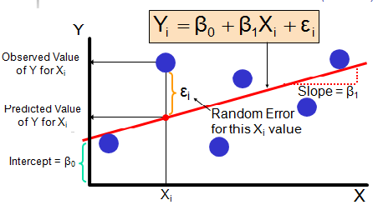
Introduction to Linear Regression
Linear Regression is a linear model that assumes a linear relationship between input variables(independent variables ‘x’) and output variable(dependent variable-’y’) such that ‘y’ can be calculated from a linear combination of input variables(x).For single input variable, method is referred to as Simple Linear Linear Regression whereas for multiple input variables it is referred to as Multiple Linear Regression
Linear Regression Model Representation :

Slide 3
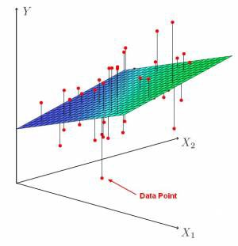
In higher dimensions when we have more than 1 input variables the line is now replaced by a plane or hyper plane.

Slide 4
APPLICATIOPN
Linear regression is widely used in biological, behavioural and social sciences to describe possible relationships between variables. It ranks as one of the most important tools used in these disciplines.
Trend line
A trend line represents a trend, the long-term movement in time series data after other components have been accounted for. It tells whether a particular data set (say GDP, oil prices or stock prices) have increased or decreased over the period of time. A trend line could simply be drawn by eye through a set of data points, but more properly their position and slope is calculated using statistical techniques like linear regression. Trend lines typically are straight lines, although some variations use higher degree polynomials depending on the degree of curvature desired in the line.

Slide 5
Epidemiology Early evidence relating tobacco smoking to mortality and morbidity came from observational studies employing regression analysis. In to reduce spurious correlations when analyzing observational data, researchers usually include several variables in their regression models in addition to the variable of primary interest. For example, in a regression model in which cigarette smoking is the independent variable of primary interest and the dependent variable is lifespan measured in years, researchers might include education and income as additional independent variables, to ensure that any observed effect of smoking on lifespan is not due to those other socio-economic factors. However, it is never possible to include all possible confounding variables in an empirical analysis. For example, a hypothetical gene might increase mortality and also cause people to smoke more
Finance
The capital asset pricing model uses linear regression as well as the concept of beta for analyzing and quantifying the systematic risk of an investment. This comes directly from the beta coefficient of the linear regression model that relates the return on the investment to the return on all risky assets.

Slide 6
Economics Linear regression is the predominant empirical tool in economics. For example, it is used to predict consumption spending, fixed investment spending, inventory investment, purchases of a country's exports, spending on imports, the demand to hold liquid assets, labour demand, and labour supply.
Environmental science
Linear regression finds application in a wide range of environmental science applications. In Canada, the Environmental Effects Monitoring Program uses statistical analyses on fish and benthic surveys to measure the effects of pulp mill or metal mine effluent on the aquatic ecosystem.
Machine learning
Linear regression plays an important role in the subfield of artificial intelligence known as machine learning. The linear regression algorithm is one of the fundamental supervised machine-learning algorithms due to its relative simplicity and well-known properties.

Slide 7
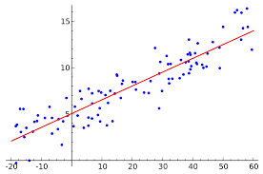
What is simple linear regression? regression models describe the relationship between variables by fitting a line to the observed data. Linear regression models use a straight line, while logistic and nonlinear regression models use a curved line. Regression allows you to estimate how a dependent variable changes as the independent variable(s) change.
Simple Linear Regression

Slide 8
How simple linear regression works? Simple linear regression is a regression model that estimates the relationship between one independent variable and one dependent variable using a straight line. Both variables should be quantitative. ... Linear regression most often uses mean-square error (MSE) to calculate the error of the model. Uses of simple linear regression Three major uses for regression analysis are (1) determining the strength of predictors, (2) forecasting an effect, and (3) trend forecasting. First, the regression might be used to identify the strength of the effect that the independent variable(s) have on a dependent variable.

Slide 9
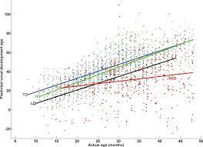
Multiple Linear Regression What is multiple linear regression Multiple linear regression (MLR), also known simply as multiple regression, is a statistical technique that uses several explanatory variables to predict the outcome of a response variable. The goal of multiple linear regression (MLR) is to model the linear relationship between the explanatory (independent) variables and response (dependent) variable.

Slide 10
Difference Between Linear and Multiple Regression regression compares the response of a dependent variable given a change in some explanatory variables. However, it is rare that a dependent variable is explained by only one variable. In this case, an analyst uses multiple regression, which attempts to explain a dependent variable using more than one independent variable. Multiple regressions can be linear and nonlinear. What makes a multiple regression 'multiple'? A multiple regression considers the effect of more than one explanatory variable on some outcome of interest. It evaluates the relative effect of these explanatory, or independent, variables on the dependent variable when holding all the other variables in the model constant.

Slide 11
THANK YOU

